Slide 1
BIRDVILLE ISD department BUDGET MEETING
December 5, 2022

Slide 2
Budget resources
Budget Development Calendar
2023-24 Summary Budget Worksheet
2023-24 Department Detail Budget Worksheet
Available on District website Finance/Financial Reports/Budget/District Budget Preparation Documents https://www.birdvilleschools.net/Page/59647
General Fund Budget Position Form Position Review Request Form
Request – Additional Non-Personnel New Account Code Request Form
Facilities Modification Request Furniture Request
Budget Code Helpful Hints Sample Teacher/Staff Request Form

Slide 3
Budget Process

Slide 4
Budget development calendar

Slide 5
Department Budget Resources
Funding
ESSA Financial Transparency reporting will utilize these funds in the per pupil expenditure calculation
Campus Site-Base Fund 199 Allotment
Campus Funds – Fund 461
Federal Funds – i.e. Fund 211, etc.
District Staff
Department staff should have input into the budget development for your department
Campus Staff should have input into the budget development for the part of your department budget that affects their campus
District budget staff are available should you need their assistance

Slide 6
district Improvement Plan
Resources should be allocated based on addressing the goals of the district Improvement Plan
Budget to the Plan, don’t Plan to the Budget
Expenditures should be planned with a focus on the district Improvement Plan
Are they supportive of the goals
Are they curriculum driven
Are they results-oriented

Slide 7
Budget development and curriculum development should be intertwined, the latter preceding the former. The budget ought to be curriculum driven when too often that is not the case. Curriculum Management , 1987 Fenwick English

Slide 8
Planning Process Considerations
Each budget request shall be described so as to permit evaluation of consequences of funding or non-funding in terms of results
Request for Additional Non-Personnel Budget
Prioritizing of budget requests should include key educational staff, including principals and teachers
Rank ordering of requests allows flexibility in budget expansion, reduction, or stabilization based on changing needs and priorities.
Budget requests publicly compete with each other for funding based upon evaluation of need and relationship to effective instruction and campus quality.

Slide 9
Department Fund 199 Allotment
Initial Allocation – 2022-23 Adopted Budget less One-Time approved requests (see tab in worksheet)
Needs Based Budget should be submitted
Review of historical spending plays a part
Are there expenditures that you budgeted that you no longer need?
Are there budget amendments done this year that you need to include in this initial budget
New Projects?
What funding is needed?
Are there other projects that can be eliminated to fund this new project?

Slide 10
Federal Funds
Funding is specific to programs in the district with limited use
These funds can be utilized for appropriate expenditures and should be considered in the department budget planning
i.e. Staff Development
The actual expenditures are reported to TEA through the mid-year PEIMS submission
ESSA Financial Transparency reporting will utilize these funds in the per pupil expenditure calculation

Slide 11
Budget Considerations
Review Payroll information on worksheet
Create a budget and enter budget information for part-time, substitute, and extra pay budgets
Your part-time, substitute, and extra pay budgets should include the cost of related employee benefits
You won’t be responsible for entering full-time salary and benefit information in worksheets
Funds requested above proposed allocation should be included on the Detail worksheet
The Detail should equal the amount entered on the Summary Worksheet-Section 2
In notes column, please describe the additional requests added to the detailed budget worksheet.

Slide 12
Substitutes
Basic Substitute Needs – Funded by District
Employee Illness
Personal Days
Vacant Positions work w/HR
Staff Development Subs
Additional Staff Development, Staff Meetings, additional help
Department should include in budget planning

Slide 13
Budget Considerations – Cont’d
Review Object code and Sub-Object Code information for accuracy
If you need additional Sub-object codes, please review with Cristina
Function 11 expenditure require a campus organization code
Can budget at organization code 999
Expenditure will require a campus organization code to be used
Please include detailed information in the budget description column-this will help the Business Office ensure that correct coding is used for the specific costs and assist Cabinet in their review.

Slide 14
Budget Considerations – Cont’d
Don’t just budget as you have in the past….
Review budget amendments that you have had to make to move funds around this year
Review recently added projects/programs to determine if future funding is needed
Review all projects/programs to determine if any can be eliminated to assist with funding of needed additional projects/programs
Make sure that new projects/programs are coded appropriately

Slide 15
Budget submission
Due January 31, 2023

Slide 16
Personnel Requests
Complete the appropriate form and include details on the Budget Summary Worksheet – Personnel Budget Request section
Submit forms with budget worksheet
Include Job Description if new position/Stipend or duties have changed
Do not include staff normally received through staffing formulas or federally funded positions
If Federal funds are decreasing causing staff to be unfunded and the position is needed – you have to complete this form
General Fund Budget Position Form
Use for new positions and stipends
Include all costs associated with the position including required travel, training, furniture, etc.
Position Review Request Form
Use this form for additional days, pay grade reclassifications, unfunded federally funded positions or salary reviews
Include updated job description, if appropriate
Add to the Budget Worksheet

Slide 17
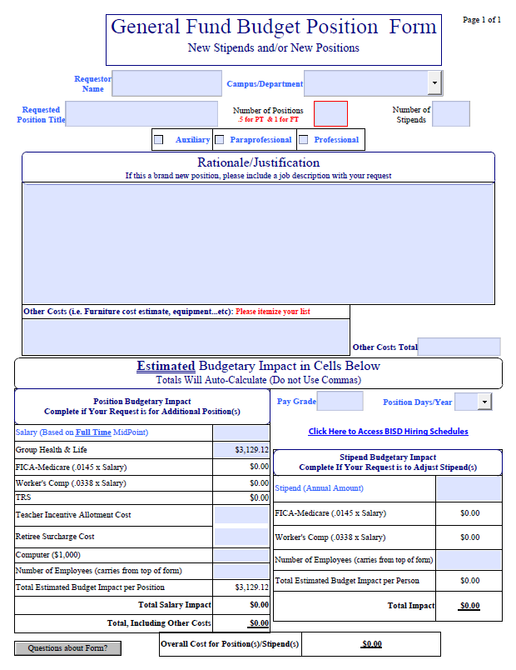
General fund budget position form
New stipends
Include a job description
New position
Include a job description
Be sure to include all costs – furniture, vehicle , etc.

Slide 18
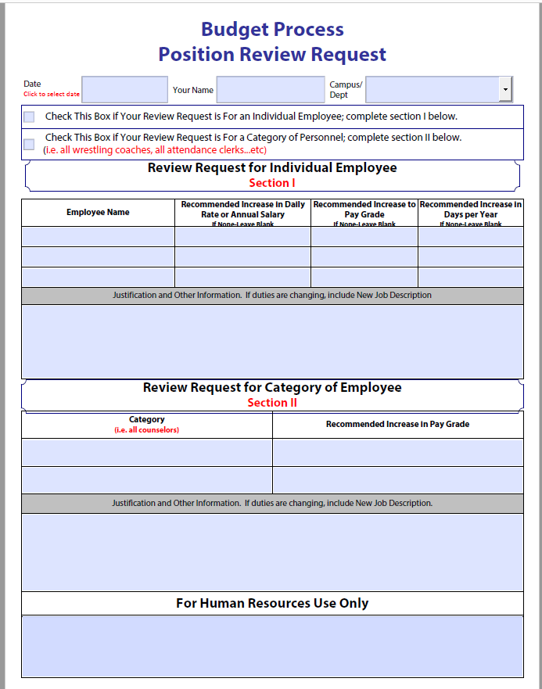
Position review request
Be sure and include a new job description if adjustment is a result of duties changing
If Federal Position will not be funded next year and you want to fund this position with local funds, this form is needed
Add to Budget Worksheet

Slide 19
Additional non-Personnel Requests
Complete the appropriate form and include details on the Budget Summary Worksheet – Additional Non-Personnel Budget Request section
Submit forms with budget worksheet
Additional Non-Personnel Budget form
Use for new programs/projects
Include all costs associated with the program/project
Facility Modification Request
Utilize for all modifications that you are considering for your campus/department that will need to be funded
If you have submitted a FMR in the past and it has not been addressed – be sure and include it in the budget process
Add to the Budget Worksheet
Furniture Modification Request
Utilize for all modifications that you are considering for your campus/department that will need to be funded
If you have submitted a FMR in the past and it has not been addressed – be sure and include it in the budget process
Add to the Budget Worksheet

Slide 20
Facility modification/Furniture Requests
Complete the appropriate form – Add to Budget Worksheet -Requests for Additional Non-Personnel Budget and Submit with Budget worksheet
Include enough information for the respective departments to complete cost estimates
Will be reviewed by Cabinet
Once Endorsed by Cabinet – Respective Department will provide cost estimates
Will be considered in budget funding prioritization process

Slide 21
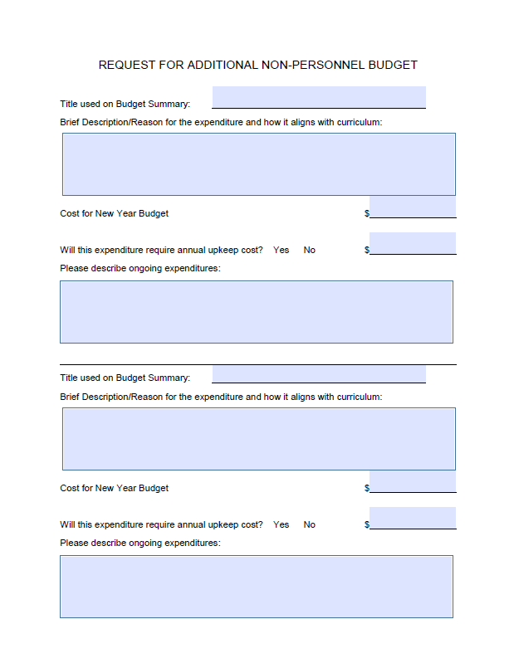
request for additional non-personnel budget
This will need to be submitted for each project/expenditure you request
Title so that form and line item can be tied together
Include detailed information
Remember this is the information that will be used to determine if funding will occur
Include on Budget Summary worksheet

Slide 22
Facility modification request
Utilize for all modifications that you are considering for your campus/department that will need to be funded
If you have submitted a FMR in the past and it has not been addressed – be sure and include it in the budget process
Include the Project on the Budget Worksheet -Requests for Additional Non-Personnel Budget

Slide 23
furniture modification request
Utilize for all modifications that you are considering for your campus/department that will need to be funded
If you have submitted a FMR in the past and it has not been addressed – be sure and include it in the budget process
Include the Project on the Budget Worksheet -Requests for Additional Non-Personnel Budget

Slide 24
Budget Submission Process – department Summary Budget Worksheet
First Section-Proposed Incr(Decr) within my Initial Allocation
Include any major budget allocation changes within allotment in this section
Not to exceed 2022-23 initial allocation
Can be less than the 2022-23 initial allocation
Second Section-Requests for Additional Non-Personnel Budget
Include any “non-personnel” requests in this section
Don’t forget to include Facilities Modifications and Furniture Modifications
Don’t forget to submit Forms needed to support requests
This represents amounts over your campus allotment
These amounts should be entered on the 2023-24 Department Detail Budget Worksheet

Slide 25
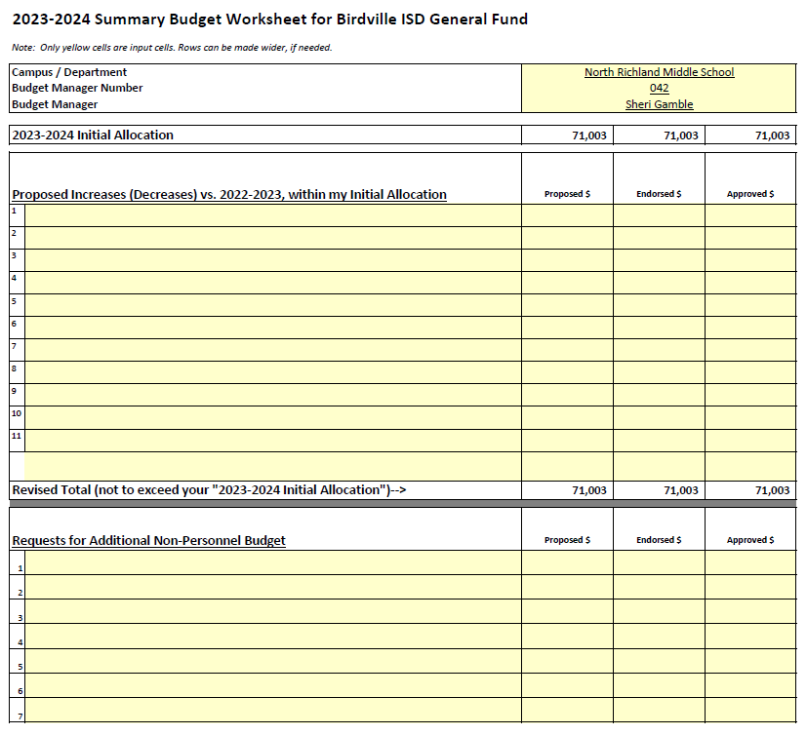

Slide 26
Budget Submission Process – department Summary Budget Worksheet
Third Section – Requests for New Positions & Position Review/Reclassification
Include description of General Fund Budget Position form(s) submitted
Include description of Position Review Request form(s) submitted
Don’t forget to include current Federally funded positions that will need to be moved to General Operating
Do not include staff normally received through staffing formulas
Don’t forget to submit the appropriate form

Slide 27
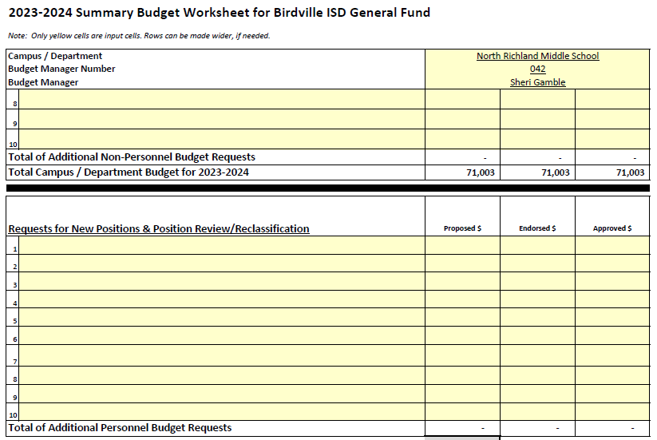

Slide 28
Budget Submission Process – Department Detail Budget Worksheet
General Fund (Fund 199) only
Grant budgets will be developed later in the Spring
Initial Allocation is included at the top of the worksheet
Enter detailed proposed budget into the 2023-24 Proposed Budget column

Slide 29
Budget Submission Process – department Detail Budget Worksheet
Enter 2023-24 Information in the following columns: (proposed allocation will be provided in cell o1)
Budget Description-Provide description of costs that will be spent from each budget category (column M)
Detailed Requests-Optional (column O)
2023-24Total Budget Request (column P)
Summary of details
Total should match Summary Worksheet (Total of Initial Allocation + Additional Non-Personnel)
Label each request as “operational” or “project” cost (column Q)
List any other notations in the “Notes” column (column R)
Add any new lines of information as needed to the bottom of the worksheet (if you add lines inside worksheet, be sure to highlight entire row before inserting)
Ensure that totals at top of page include all lines of data

Slide 30
District Budget Coding
Notes:
Christy Presents
Handout Flip Charts -- Christy
Hand out Quicktips sheet -- Dora

Slide 31
We need your help!
You know more about the purchase/expenditure than we do

Slide 32
Budget Coding
Account Code Requirements-Data required by TEA
XXX-XX-XXXX-XX-XXX-XX-XXX - XXXXX
BUDGET
MGR
F
U
N
D
F
U
N
C
T
I
O
N
O
B
J
E
C
T
SUB - OBJECT
O
R
G
A
N
I
Z
A
T
I
O
N
P
R
O
G
R
A
M
P
R
O
JECT

Slide 33
FUND
Funding source
XXX-XX-XXXX-XX-XXX-XX-XXX-XXXXX
100’s-General Fund
200-400’s-Special Revenue Funds
461 – Campus Activity Fund
500’s-Debt Service Funds
600’s-Capital Project Funds (Bond Projects)
800’s – Agency Funds
865 – Student Activity Fund
890 – Faculty Activity Fund

Slide 34
FUNCTION - Purpose of the Expenditure XXX-XX-XXXX-XX-XXX-X-XX-XXX
11 Instruction (Activities directly between teachers and students) *
12 Instructional Resources and Media (Library) *
13 Curriculum Development and Instructional Staff Development *
21 Instructional Leadership
23 School Leadership (Principal & Office Staff) *
31 Guidance, Counseling, and Evaluation Services *
32 Social Work Services
33 Health Services (Nurses) *
34 Student (Pupil) Transportation (To/From School Only)
35 Food Services (Cafeteria Services Only)
36 Cocurricular/Extracurricular Activities *
41 General Administration (Administration Offices)
51 Plant Maintenance and Operations
52 Security and Monitoring Services
53 Data Processing Services
61 Community Services
71 Debt Service (capital leases)
81 Facilities Acquisition and Construction

Slide 35
OBJECT CODE
Nature or Object of account
XXX-XX-XXXX-XX-XXX-XX-XXX-XXXXX
6100’s-Employee Salary and Benefits
6200’s-Professional & Contracted Services
6300’s-Supplies & Equipment < $5,000 per unit cost
6400’s-Dues, Travel, Food and Other Expenses
6600’s-Capital Assets >$5,000 per unit cost

Slide 36
Payroll Costs Object 6100
Substitutes – 6112
Part-Time Employees (no benefits)
XX-6118 Professional
XX-6126 Part-Time Support Personnel
Extra Pay Full-Time Employees
XX-6118 Professional Stipends & Extra Duty Pay
XX-6121 Extra Duty Pay/Overtime Support Personnel
Note: There should be no 6119 or 6129 object codes in campus or department budgets. These are for full-time positions only.

Slide 37
Professional & Contracted Services Object 6200
Professional Services (typically a licensed individual)
XX-6219
Student Tuition
11-6229
Education Service Centers Contracted Services
XX-6239
Maintenance & Repair Services
XX-6249
Rentals/Operating Leases (copier leases)
XX-6269

Slide 38
Professional & Contracted Services Object 6200 (cont’d)
Consulting Services (performance improvement)
XX-6291
Print Shop Services
XX-6399-P1 (not 6294)
Other Contracted Services
XX-6299

Slide 39
Supplies and Materials Object 6300
Gasoline and Fuel-district vehicles
XX-6311
Maintenance/Operations-custodial and building maintenance supplies
51-6319
Textbooks-textbooks purchased by district furnished free to students
11-6321
Reading Materials-magazine/newspaper subscriptions and books (not workbooks)
XX-6329
Testing Materials
11-6339 – instructional tests
31-6339 – standardized tests
Child Nutrition Only
35-6341 – 6349

Slide 40
Supplies and Materials Object 6300 (continued)
Supplies, Furniture, Equipment (unit cost < $5,000)
XX-6398 Computer Equipment
XX-6399-SF Software Licenses
XX-6399-CQ Copier Clicks
XX-6399-FU Furniture
XX-6399-P1 Print Shop
XX-6399-PA Paper
XX-6399 All other supplies and equipment

Slide 41
Other Operating Costs Object 6400
Employee Travel-registration fees, transportation, meals, hotel, etc.
11-6411 Teacher Instruction Related (Field trips & between campuses)
13-6411 Teacher Staff Development/Training
XX-6411 All Other Employees
Student Travel-transportation, meals, participation fees, hotel, etc. related to students traveling for school sponsored events
11-6412 Regular Instruction (field trips)
36-6412 Extracurricular/Cocurricular
6494 District transportation department charges only

Slide 42
Other Operating Costs Object 6400 (continued)
Non-Employee Travel-registration fees, transportation, meals, and hotel for non-district employees participating in school sponsored events
XX-6419
Insurance- property insurance, liability insurance, bonding costs, and athletic insurance
XX-6429
Dues-not associated with travel (fees should be 6499)
XX-6495
Awards
XX-6498

Slide 43
Other Operating Costs Object 6400 (continued)
Miscellaneous Operating Costs-fees, bid notices, newspaper advertisements, food/refreshments for school related meetings, other miscellaneous costs not coded elsewhere
41 – 6491 Statutorily Required - Bid notices, newspaper advertisements/notices
XX-6399-F1 Food (non-catered)
Includes meals and snacks
Excludes coffee products and water (code to 6399)
XX-6499-F1 Food (catered)

Slide 44
Sub-Object
District Local Option provides additional account description
XXX-XX-XXXX-XX-XXX-XX-XXX-XXXXX
Can be used to help budget manager to break budget into project/grade levels/etc. to manage budget at a more specified level

Slide 45
ORGANIZATION NUMBER
XXX-XX-XXXX-XX-XXX-XX-XXX-XXXXX
001-040 High Schools
041-100 Middle Schools
101-698 Elementary Schools
699 Summer School
700-750 General Administration
800-997/999 Undistributed
Function 11 requires 001-699 organization code on all expenditures

Slide 46
PROGRAM INTENT CODE - Intent of program provided to students – Very important XXX-XX-XXXX-XX-XXX-XX-XXX-XXXXX
11 Basic Educational Services
21 Gifted and Talented
22 Career and Technology
23 Services to Students with Disabilities (Special Education)
24 SCE & At-Risk for Non-Title I Campuses
25 Bilingual Education and Special Language Programs
26 Non-disciplinary Alternative Education Programs
28 Disciplinary Alternative Education Program (base level program)
29 Disciplinary Alternative Education Program (supplemental costs)
30 SCE & At-Risk for Title I Campuses
32 Pre-Kindergarten
36 Early education allotment
37 dyslexia
38 college career military ready (CCMR)
91 Athletics and Related Activities
99 Undistributed (not readily distributed to a program intent code)

Slide 47
Local option
District Local Option used as budget manager
XXX-XX-XXXX-XX-XXX-XX-XXX-XXXXX
Computer budget access is based on the budget manager number

Slide 48
PROJECT NUMBER
Project Number used for Activity Funds and Special Projects
XXX-XX-XXXX-XX-XXX-XX-XXX - XXXXX
Mandatory for Activity Funds and Federal Funds

Slide 49
Financial Accountability System Resource Guide (FASRG)
Available on TEA Website
https://tea.texas.gov/Finance_and_Grants/Financial_Accountability/Financial__Accountability_System_Resource_Guide/
Helpful Matrices for function/object /organization decisions is available

Slide 50
Budget Monitoring

Slide 51
YTD Budget Report - Munis

Slide 52
YTD budget report
Step by Step instructions in Business Procedure Manual
Fund 199 Accounts
Activity Funds – 461
Allows for a full picture of your budget
Remember, once run, it is a point in time, not real time – Account inquiry is real time
Need help running the report, please call Cristina or Shannon

Slide 53
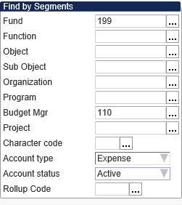
Helpful Hints
Segment Find Settings - 199 Budget
Segment Find Settings - 461 Budget

Slide 54
Account Inquiry
Live picture of your budget – Real Time

Slide 55
Review from the Browse View

Slide 56
Questions?

